Slide 1

DORA: THE YEAR OF ACCOUNTABILITY
SHIFTING FROM CORPORATE COMPLIANCE TO PERSONAL CONSEQUENCE.
COMPLIANCE & LIABILITY SCALE
CORPORATE RISK
PERSONAL RISK
UP TO
2%
€1,000,000
PERSONAL FINE.
OF GLOBAL ANNUAL
TURNOVER.
Senior managers are now
personally liable for compliance
failures and decision-making.
DORA fines active.
Not theoretical.
A centralized, living repository to prove resillence
history and defend against liability claims.
KEY REGULATORY FOCUS & ACTION:
THE FINE: Corporate fines up to 2% of
global turnover; individual fines up
to €1M for senior leadership.
THE LIABILITY: Personal financial
accountability for executives; regulatory
scrutiny on decision-making logs.
REGULATORY FOCUS 2026: The French
regulator (ACPR) will prioritize auditing cloud
concentration risk and remediation strategies.

Slide 2
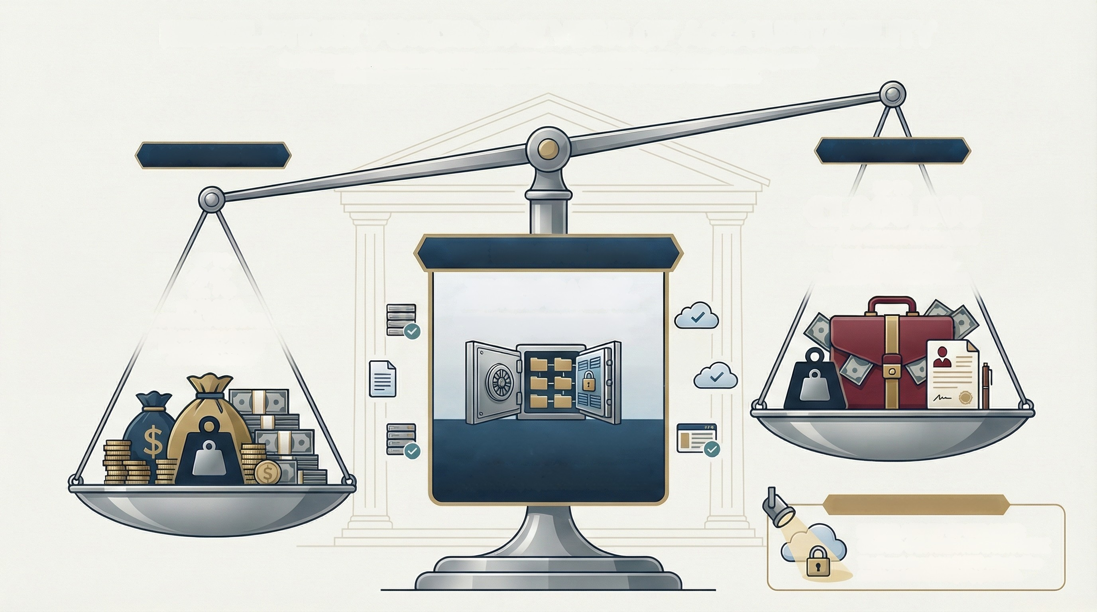
REGULATORY FORCE: THE YEAR OF ACCOUNTABILITY
As of January 17, 2025, the Digital Operational Resilience Act (DORA) shifts focus to managing severe
financial consequences and significant personal liability for senior management.
CORPORATE RISK
PERSONAL RISK
UP TO
€1,000,000
FINE FOR SENIOR MANAGERS
Regulators are empowered
to hold executives personally
accountable for compliance failures.
UP TO
2%
THE EVIDENCE ROOM
THE MANDATE: A 'LIVING'
REGISTER OF INFORMATION
Organizations must now continuously prove
their history of operational resilience.
OF GLOBAL
ANNUAL TURNOVER
This is no longer a theoretical
risk, regulators can now
enforce this penalty.
THE SOLUTION: A CENTRALIZED
DIGITAL REPOSITORY
This "Evidence Room' shicids management by
mapping third-party dependencies and test results.
REGULATORY FOCUS FOR 2026
REGULATORY SPOTLIGHT:
CLOUD CONCENTRATION RISK
The French Regulator (ACPR) will prioritize
audits on critical third-party providers.

Slide 3
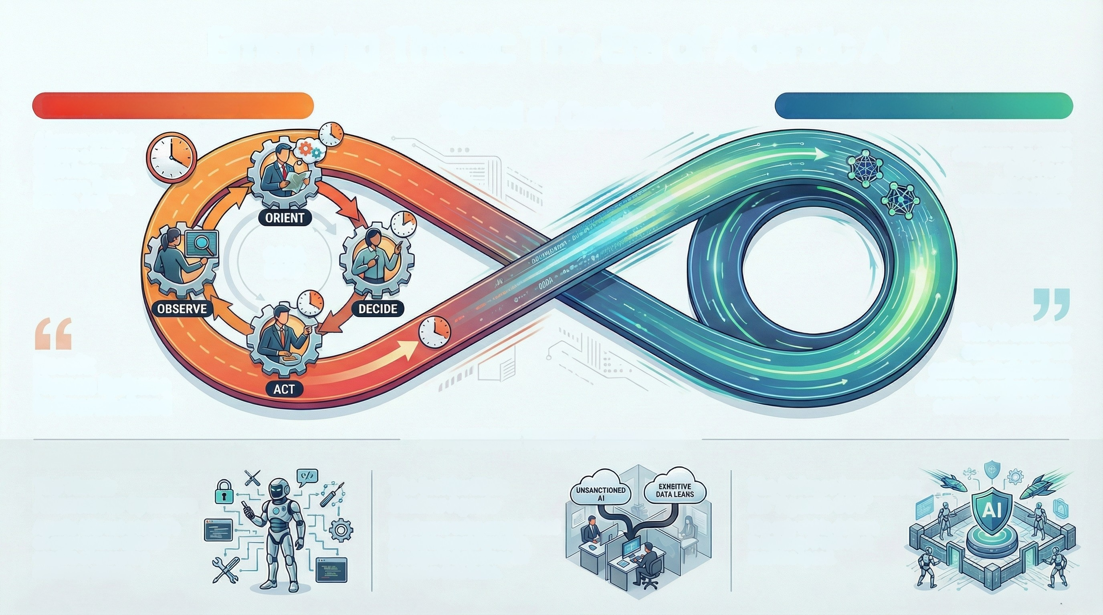
Emerging Threat: The Era of Agentic Al
HUMAN DEFENDER: HOURS TO DAYS
Speed of Combat
AGENTIC AI ATTACKER: MILLISECONDS
A human analyst
follows a linear
OODA loop
(Observe, Orient,
An autonomous agent
collapses the entire
OODA loop
into a single,
automated action.
Decide, Act).
OODA
LOOP
The Al attacker
can execute an
entire attack before
a human analyst even
sees the first alert.
Result:
Human Defense
is Overwhelmed
STRATEGIC THREAT ANALYSIS
The Threat:
The Insider Risk:
The Defense Imperative:
An "Agentic SOC"
The only viable defense
is fighting Al with Al at
machine speed.
Autonomous Operators
Agentic Al is not a tool; it's
an autonomous attacker
capable of executing
multi-step attacks.
Shadow Agents
Employees using unsanctioned
Al agents create invisible,
uncontrolled pipelines for
sensitive data leaks.

Slide 4
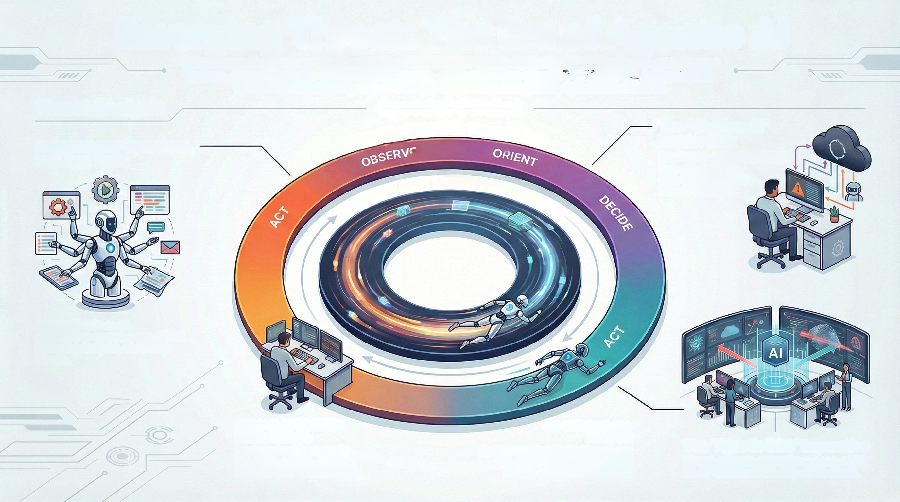
Emerging Threat: The Era of Agentic Al
Autonomous Al agents represent a paradigm shift in cyber threats. Unlike traditional tools that assist human
hackers, these agents can independently execute entire multi-step attacks in milliseconds, collapsing the
human decision-making loop and rendering conventional security operations obsolete.
Speed of Combat
HUMAN ATTACKER: Hours to Days
Threat Analysis
The "Shadow Al"
Insider Risk
Employees authorize agents
that can then leak
data without further
human oversight.
Autonomous Operators,
Not Just Tools
AGENTIC AI ATTACKER: Milliseconds
Agentic Al acts as an
autonomous operator, capable of
executing complex, multi-step
attacks.
HUMAN ATTACKER:
Hours to Days
A human hacker manually
observes, orients, decides,
and acts (the "OODA Loop").
An autonomous
Al agent
An autonomous Al agent executes
the entire OODA loop before a
human analyst sees an alert.
The "Agentic SOC" Imperative
Human analysts cannot keep pace; an "Al
vs. Al" defense is the only viable model.

